Slide 1
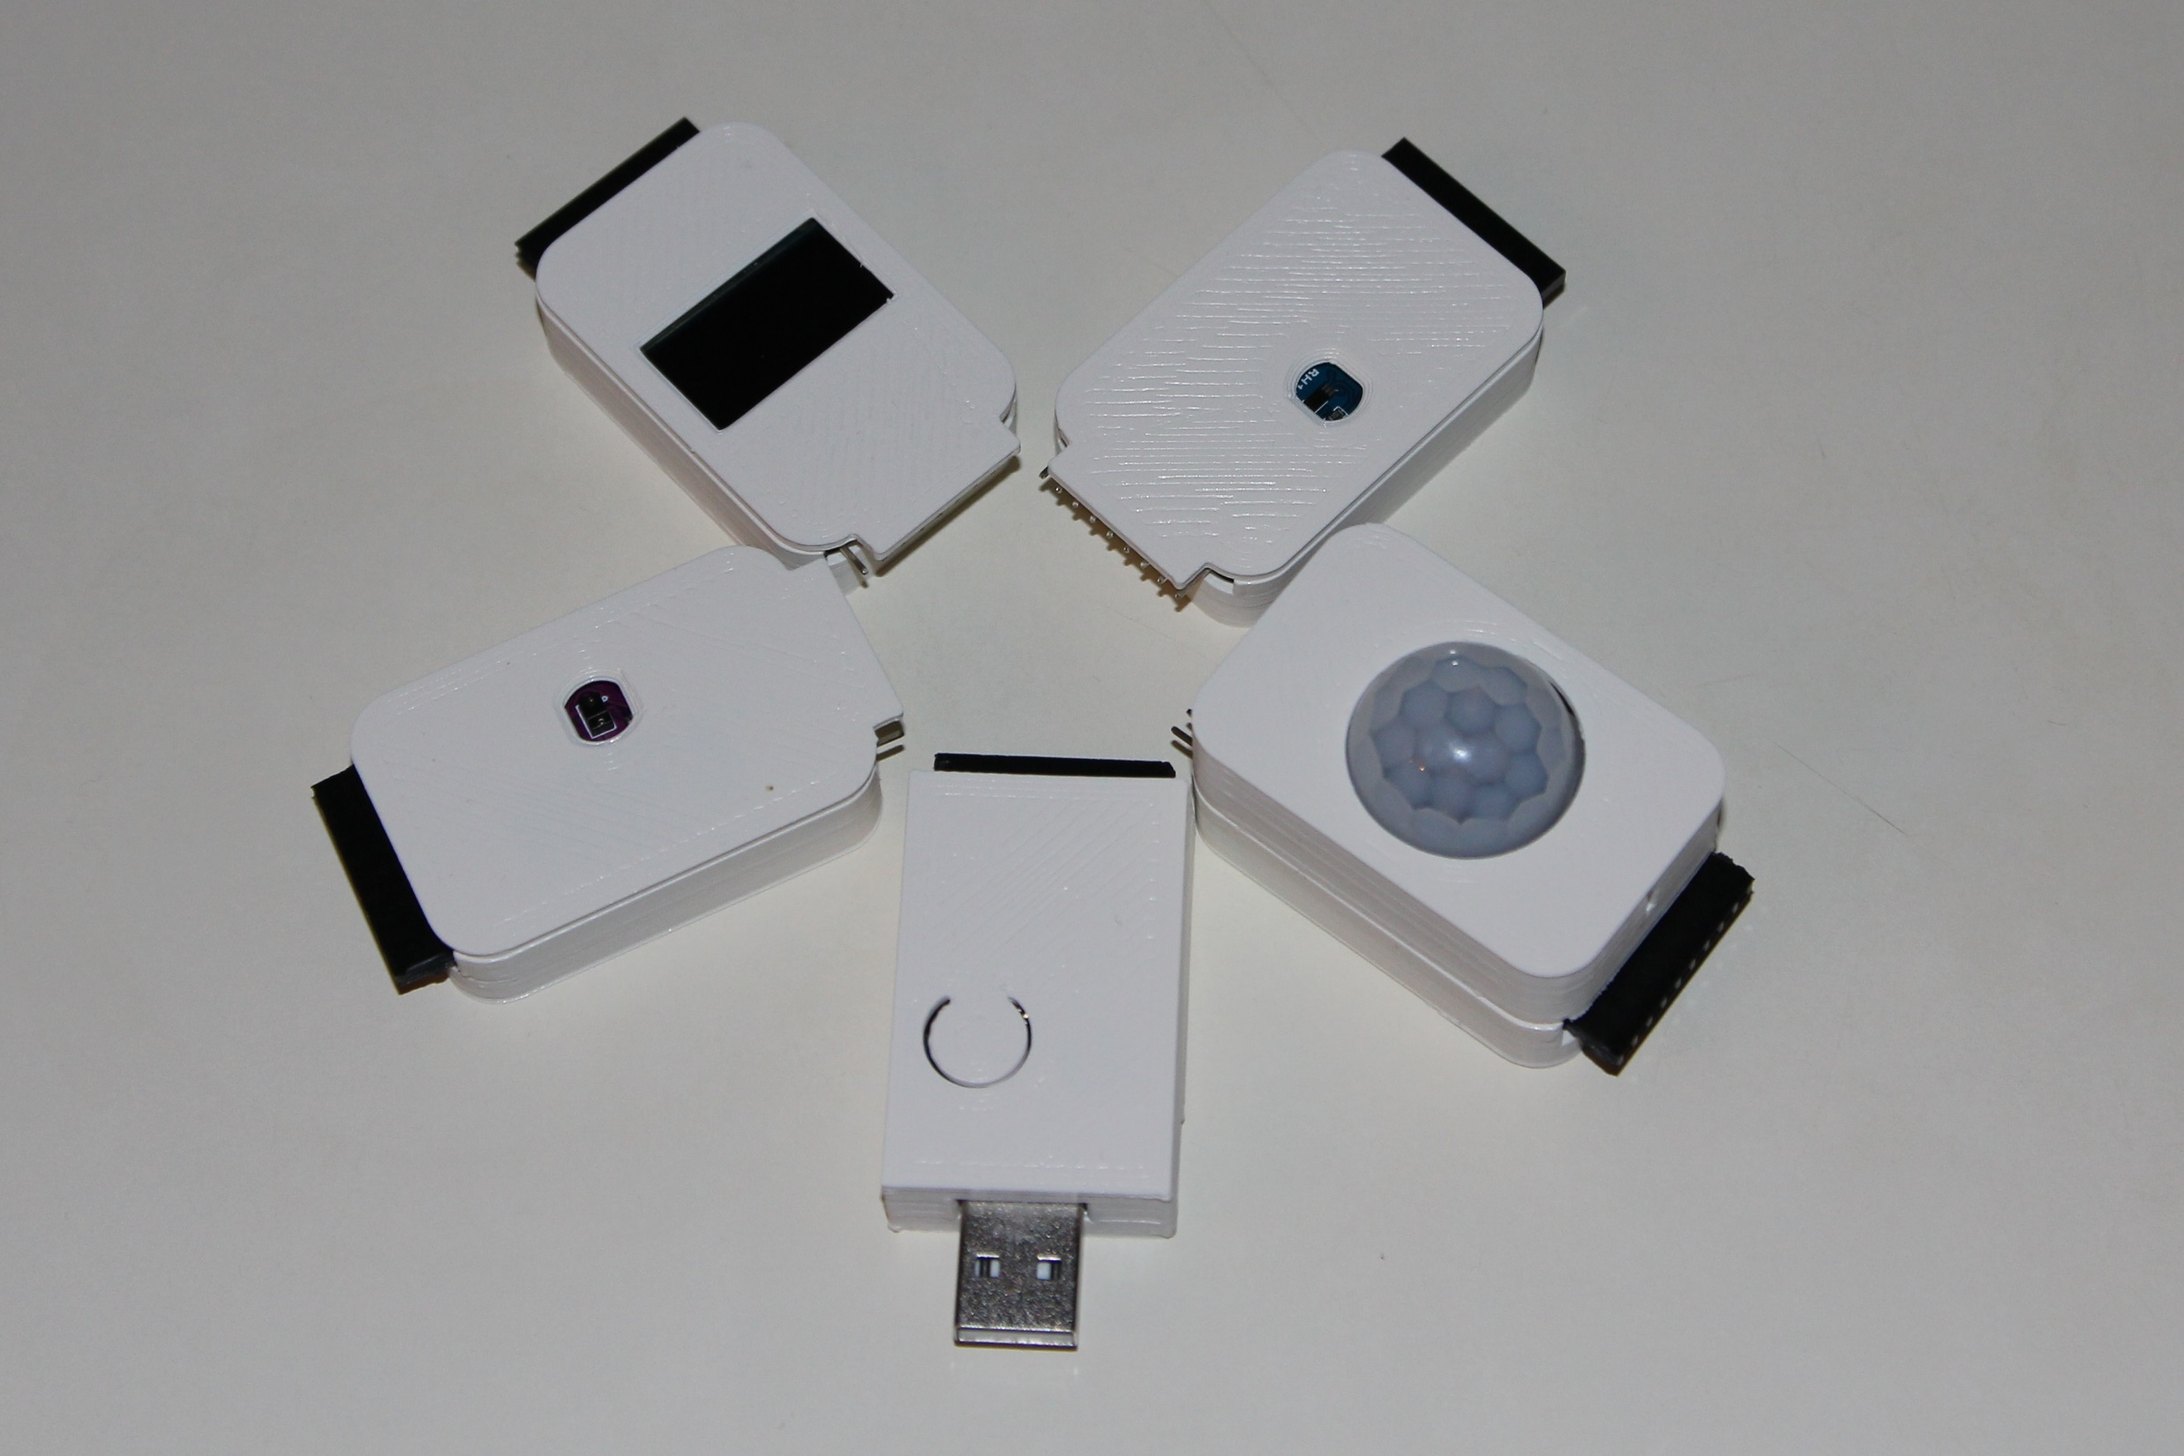
OLED 0’96”
BW 64x128
LUX Sensor
Gesture Sensor
PIR Sensor
vESPrino
Core
vESPrino
Cookies

